Slide 1


Hierarchical Clustering
Hierarchical clustering is a general family of clustering algorithms that build nested clusters by merging or splitting them successively
This hierarchy of clusters is represented as a tree (dendrogram)
The root of the tree is the unique cluster that gathers all the samples, the leaves being the clusters with only one sample

Slide 2
Agglomerative Clustering
The Agglomerative Clustering performs a hierarchical clustering using a bottom up approach: each observation starts in its own cluster, and clusters are successively merged together
The linkage criteria determines the metric used for the merge strategy

Slide 3
Linkage
Ward minimizes the sum of squared differences within all clusters
It is a variance-minimizing approach and in this sense is similar to the k-means objective function but tackled with an agglomerative hierarchical approach
Maximum or complete linkage minimizes the maximum distance between observations of pairs of clusters
Average linkage minimizes the average of the distances between all observations of pairs of clusters
Single linkage minimizes the distance between the closest observations of pairs of clusters

Slide 4
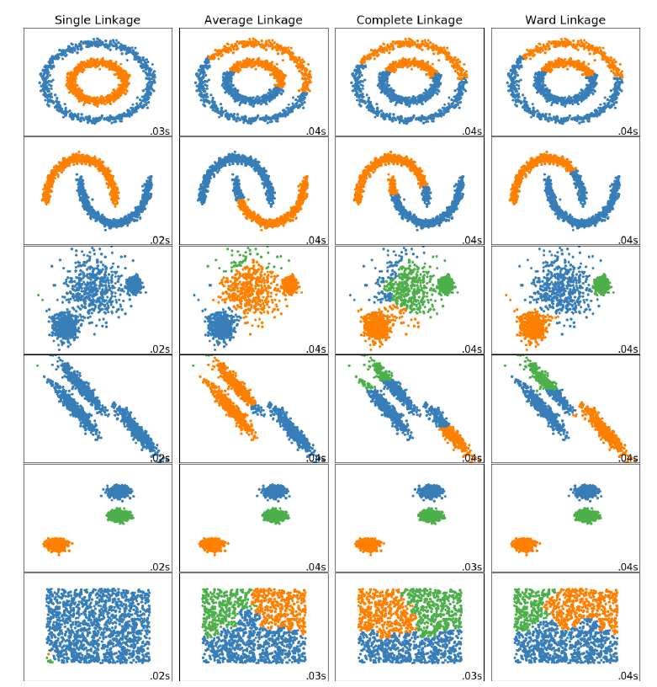

Slide 5
Linkage Properties
Agglomerative cluster has a “rich get richer” behavior that leads to uneven cluster sizes
In this regard, single linkage is the worst strategy, and Ward gives the most regular sizes
However, the affinity (or distance used in clustering) cannot be varied with Ward, thus for non-Euclidean metrics, average linkage is a good alternative
Single linkage, while not robust to noisy data, can be computed very efficiently and can therefore be useful to provide hierarchical clustering of larger datasets
Single linkage can also perform well on non-globular data

